Slide 1
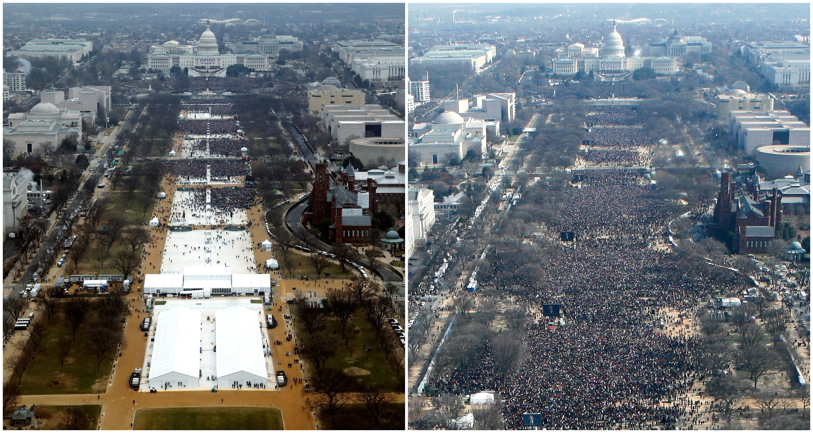

2009
2017
Data Never Lies
DIOGO.RENDEIRO@FEEDZAI.COM
@RENDEIRO (TWITTER)
Notes:
More and more we support product decisions on data. However, we are often victim to our own biases when interpreting data and when presenting it to others.
In this talk, I'll explore common pitfalls of data visualisation and provide guidelines on how to spot distortions in how the data is presented, how to prevent them, and how to design visualisations that are simple, effective, and fit for purpose.

Slide 2
I. Better Product Decisions
II. Excellence in Statistical Graphics
III. Graphical Integrity
IV. One Last Thing: Show the Data

Slide 3
Netflix A/B test results 2012-2015
15%
Losers
46%
No impact
39%
Winners
source: Jen Dante, Director of Product Innovation @Netflix
Product Management Festival, Zürich 2016

Slide 4
Booking.Com Everything is an A/B test
90%
Losers / Meh
10%
Winners
source: PM Experimentation Booking.Com
MtP Engage Hamburg, April 2018

Slide 5
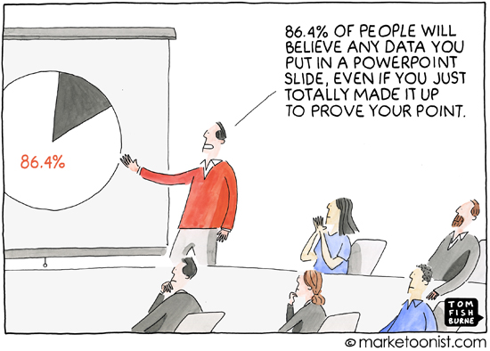
Notes:
Not any data though. If someone presents you figures, you need to think of two things: SOURCE? RAW DATA.

Slide 6

Notes:
Don’t trust authority pledges => Show me the data

Slide 7

Show me the data!
Notes:
Don’t trust authority pledges => Show me the data

Slide 8
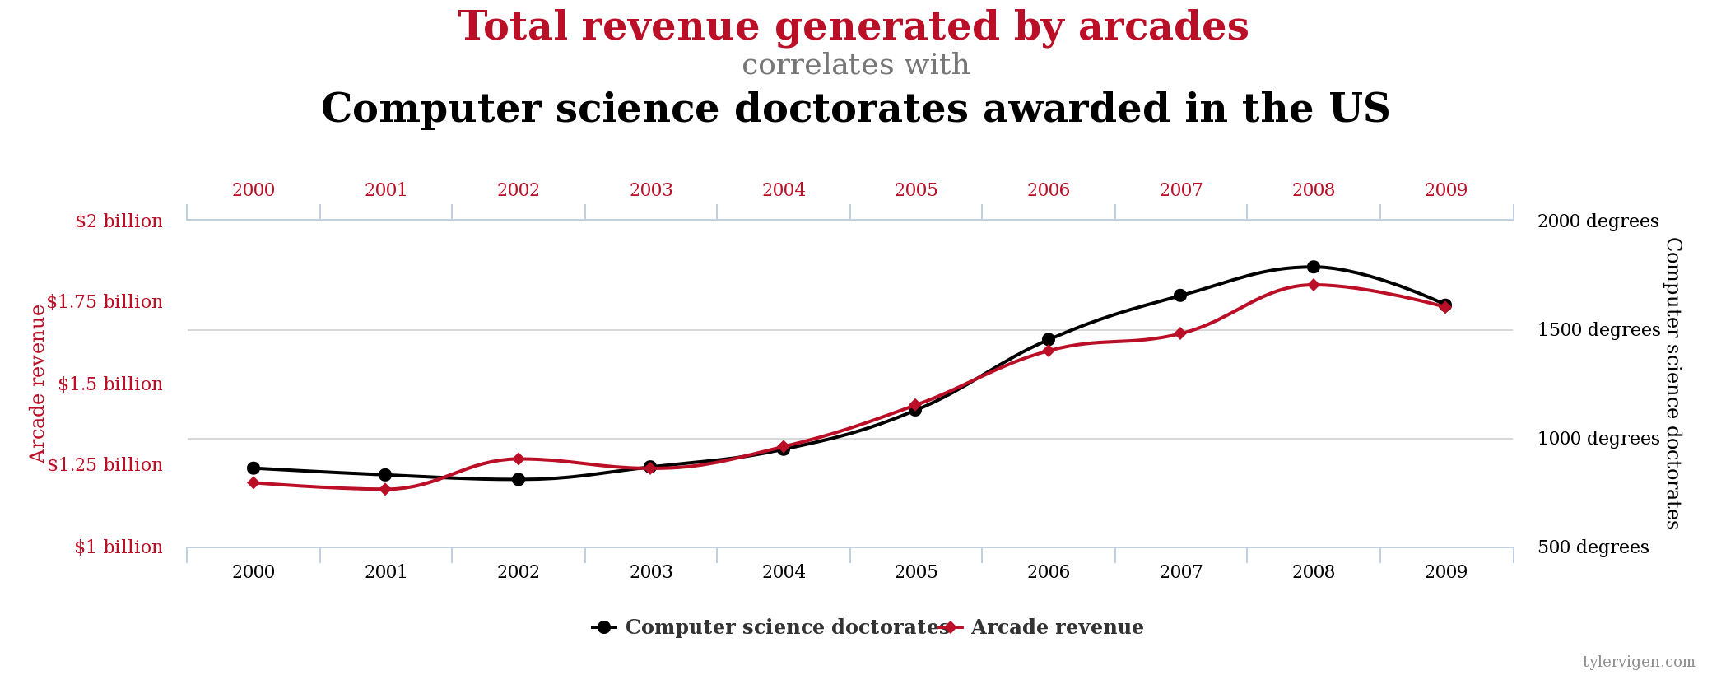
correlation may be accidental
r = 0,9851

Slide 9
I. Better Product Decisions
II. Excellence in Statistical Graphics
III. Graphical Integrity
IV. One Last Thing: Show the Data

Slide 10
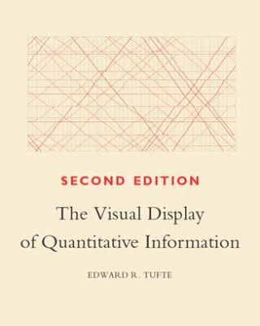

“Excellence in statistical graphics consists of complex ideas communicated with clarity, precision, and efficiency.”
Edward R. Tufte

Slide 11
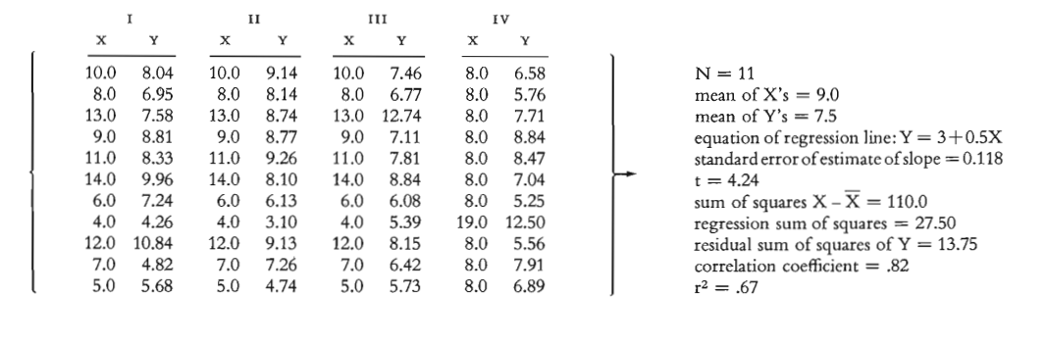
Graphics reveal data.
Notes:
First, let me convince you of why graphics are not just nice to look at. Indeed, graphics can be more precise and revealing than typical statistical aggregates like the mean of a data set.
Consider Anscombe’s quartet: all 4 data-sets are described by the same linear model.

Slide 12
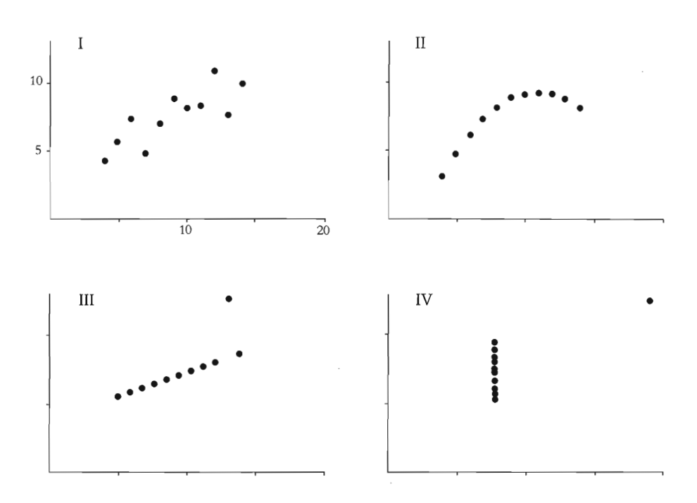
Graphics reveal data.
Notes:
Graphical excellence

Slide 13
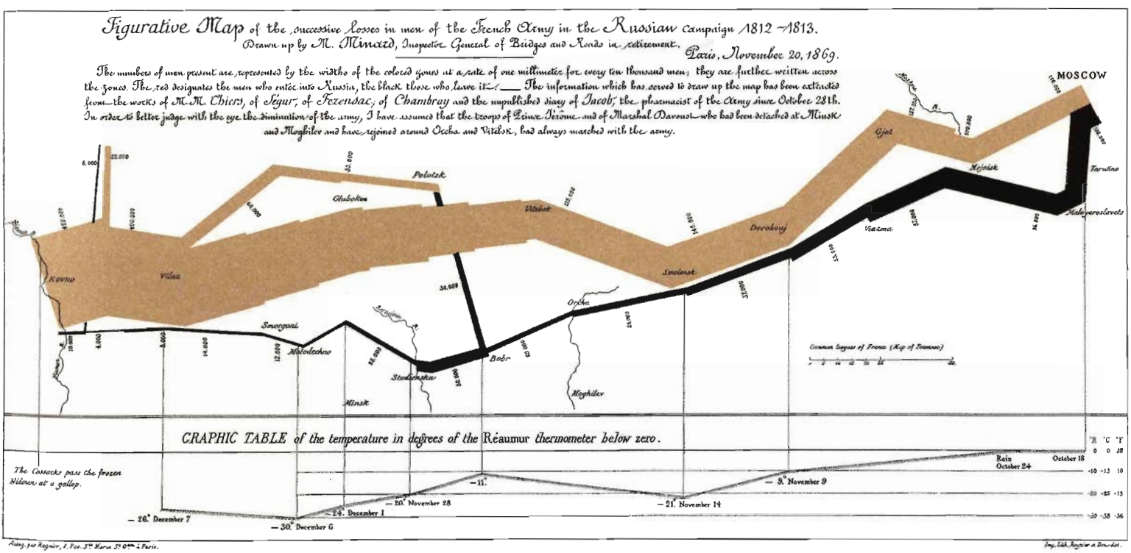
Infographics should be multivariate.
6 types of data: number of troops, distance traveled, direction of travel, temperature, latitude and longitude and location relative to specific dates.
Notes:
Encourage the viewer to explore and make comparisons among the data.
Here an infamous illustration of Charles Minard from early 1800’s depicting Napoleon's army departing the Polish-Russian border.
A thick band illustrates the size of his army at specific geographic points during their advance and retreat. It displays six types of data in two dimensions.

Slide 14
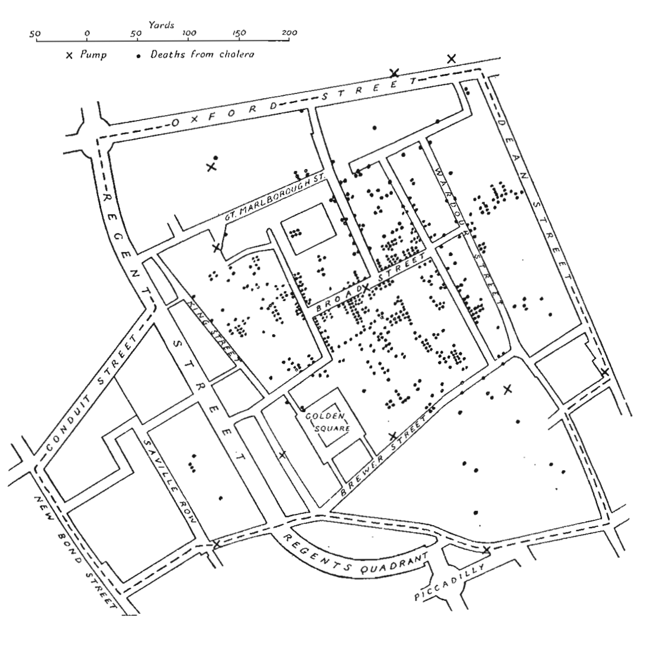
“Graphical excellence is what gives to the viewer the greatest number of ideas in the shortest time with the least ink.”
Edward R. Tufte
Notes:
Map by Dr John Snow, 1854, documenting wells and cholera deaths led to identify clusters. 19th century
Skeptic of the then-dominant theory: diseases caused by pollution in the air. The germ theory of disease had not yet been developed, so Snow did not understand the mechanism by which the disease was transmitted. His observation of the evidence led him to discount the theory of foul air.

Slide 15
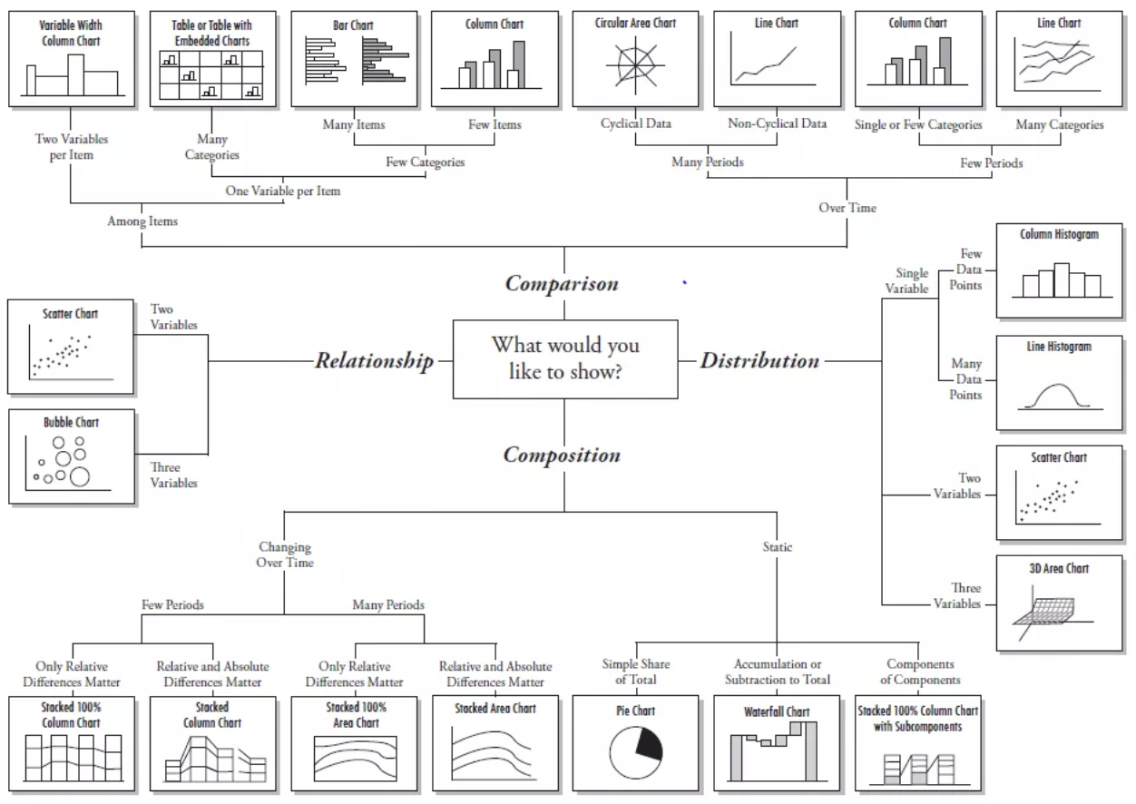
DataViz 101: Pick the tool that fits the job
Chart Chooser by Dr. Andrew V. Abela http://extremepresentation.typepad.com/

Slide 16
I. Better Product Decisions
II. Excellence in Statistical Graphics
III. Graphical Integrity
IV. One Last Thing: Show the Data

Slide 17
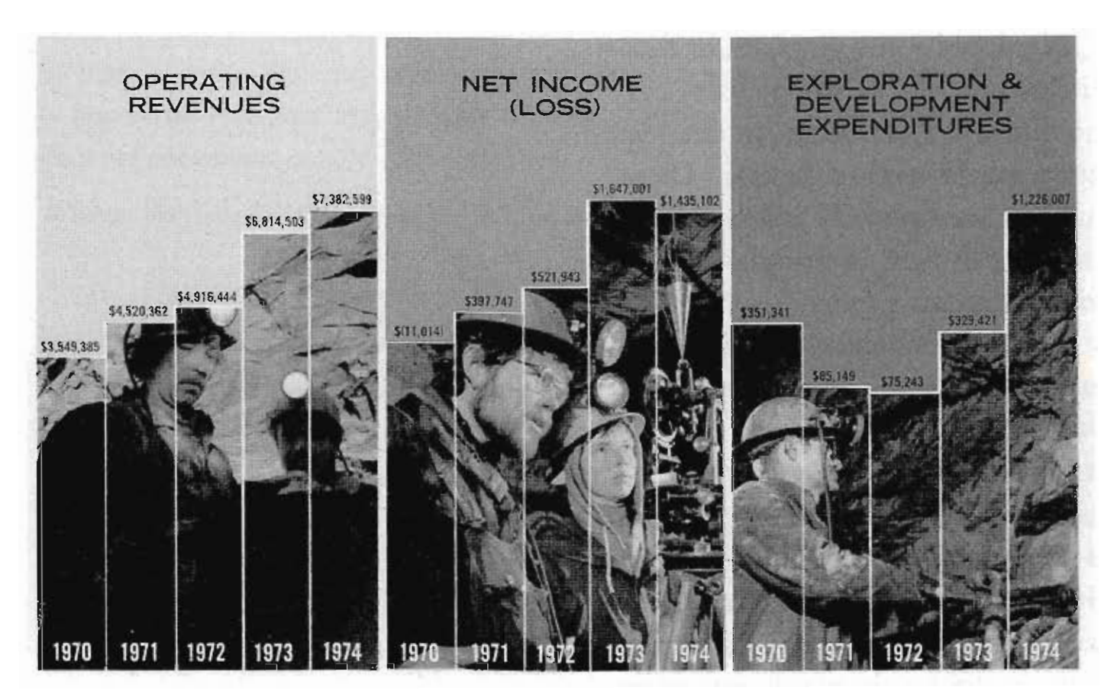
Infographics lacking integrity
Day Mines, Inc., 1974 Annual Report, p. 1

Slide 18

Infographics lacking integrity
Day Mines, Inc., 1974 Annual Report, p. 1

Slide 19
Infographics lacking integrity
Day Mines, Inc., 1974 Annual Report, p. 1
-$4.200.000

Slide 20
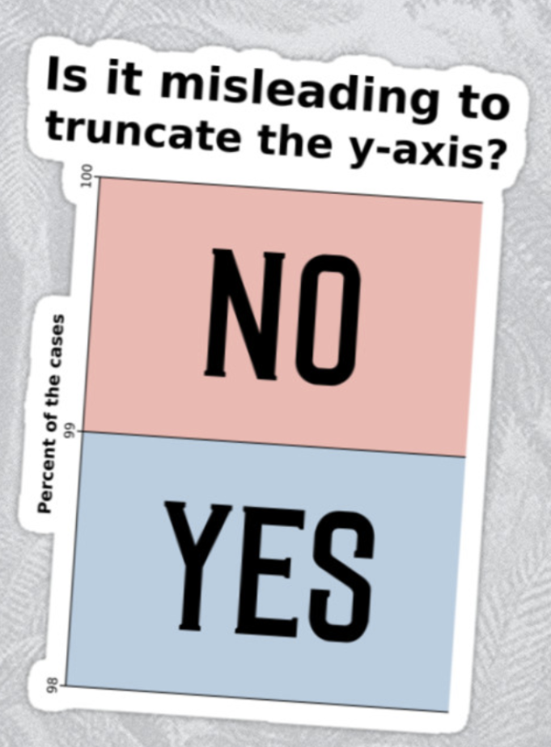
Infographics lacking integrity
-$4.200.000

Slide 21

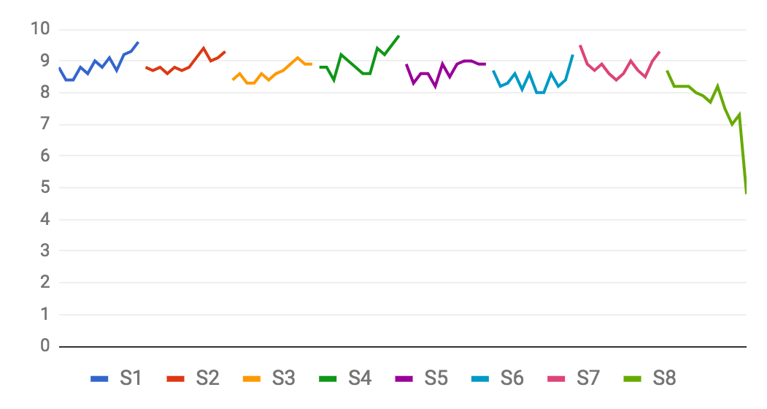

Infographics lacking integrity

Slide 22
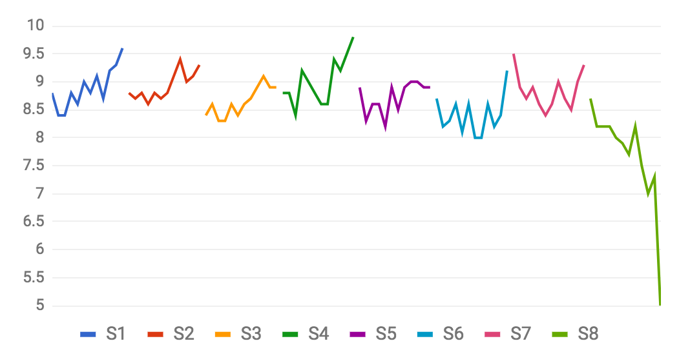
Infographics lacking integrity

Slide 23
Infographics lacking integrity

Slide 24
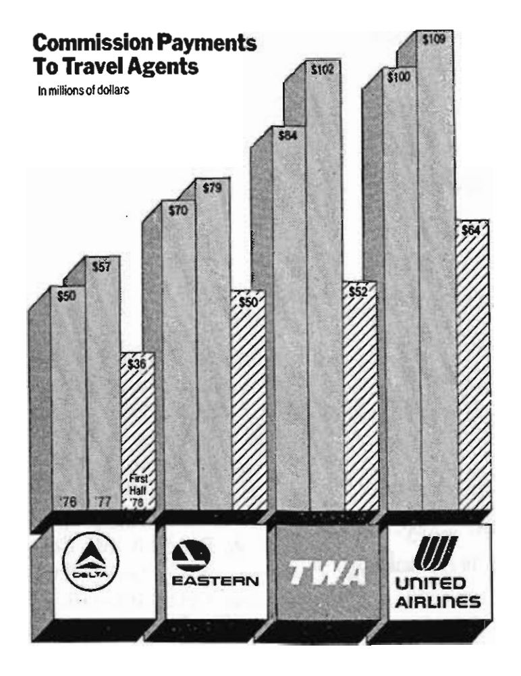
Infographics lacking integrity
New York Times
8/8/1978

Slide 25
Infographics lacking integrity
New York Times
8/8/1978
Pseudo decline created by comparing half year worth of payments in ‘78 with full year’s worth in ‘76, ‘77.
Lie repeated 4 times.

Slide 26
Infographics lacking integrity
New York Times
8/8/1978
Clear detailed labels, should explain distortion and events, on the graphic.

Slide 27
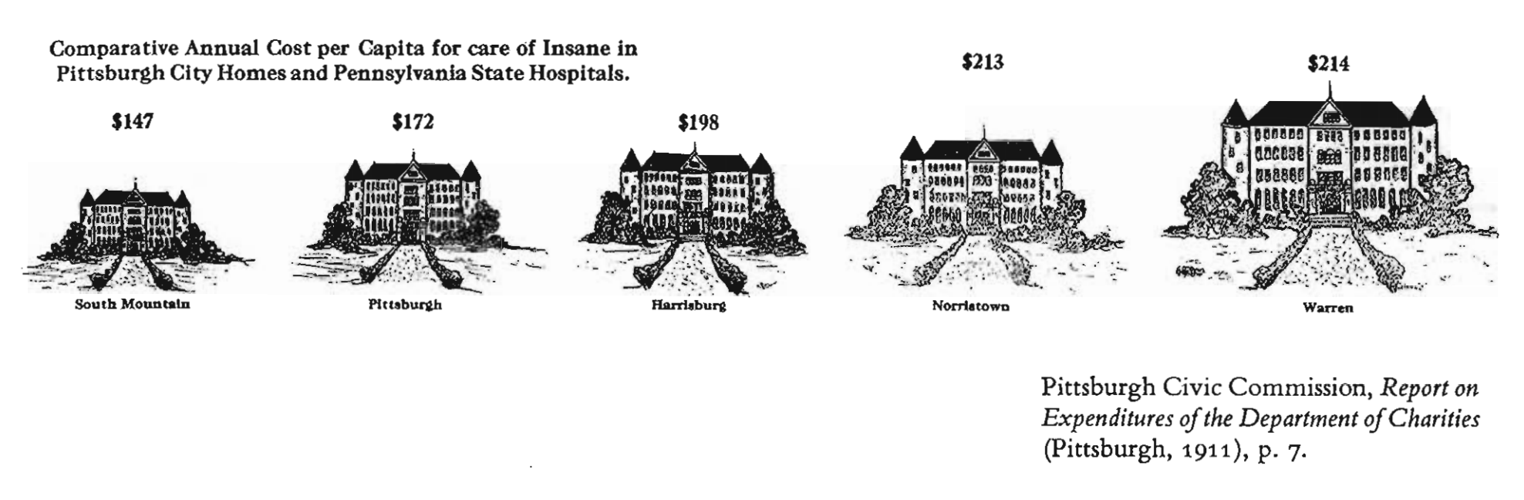
Infographics lacking integrity

Slide 28
Distortion in statistical graphics
+$25 (17,0%)
+$1 (0,5%)
Graphical representations of numbers should be proportional to the numerical quantities represented.

Slide 29
Measuring distortion in statistical graphics
size of effect shown in graphic
Lie Factor =
size of effect in the data

Slide 30
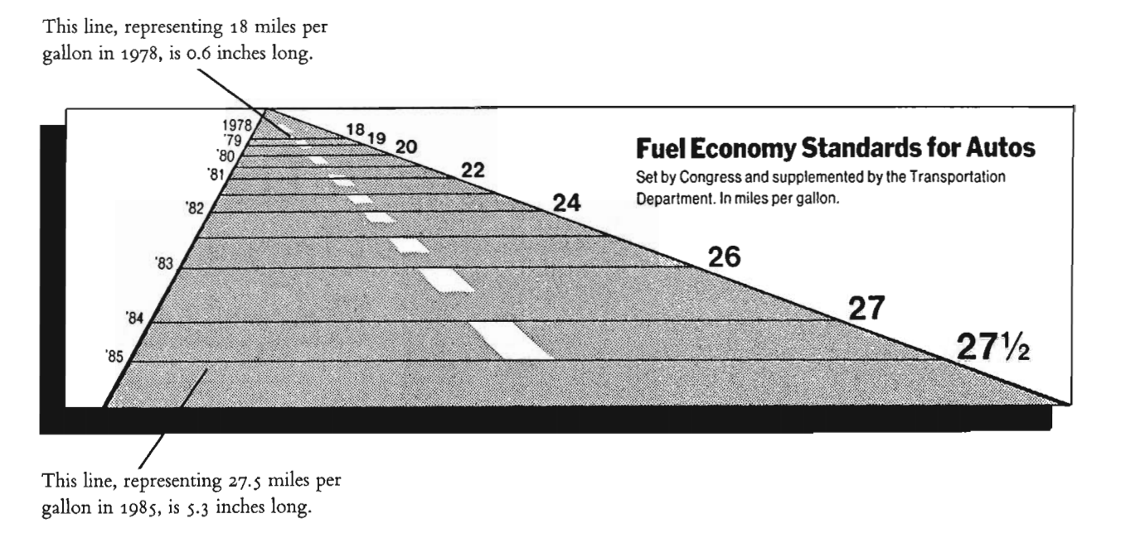
Measuring distortion in statistical graphics
New York Times, August 9, 1978
Notes:
context

Slide 31
Distortion in statistical graphics
Lie Factor = 14.8
New York Times, August 9, 1978
Notes:
context

Slide 32
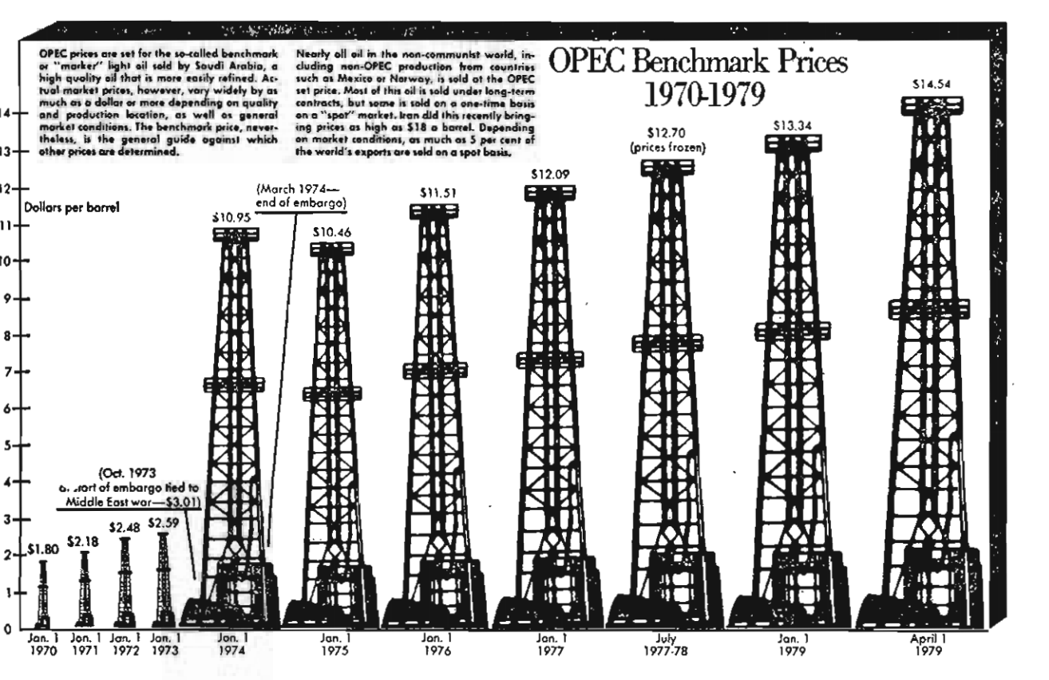
Distortion in statistical graphics
real increase: 708%
shown as: 6700%
lie factor = 9,5
Washington Post,
March 29, 1979
Notes:
The 1972 dollar was worth more than the 1979 dollar.

Slide 33
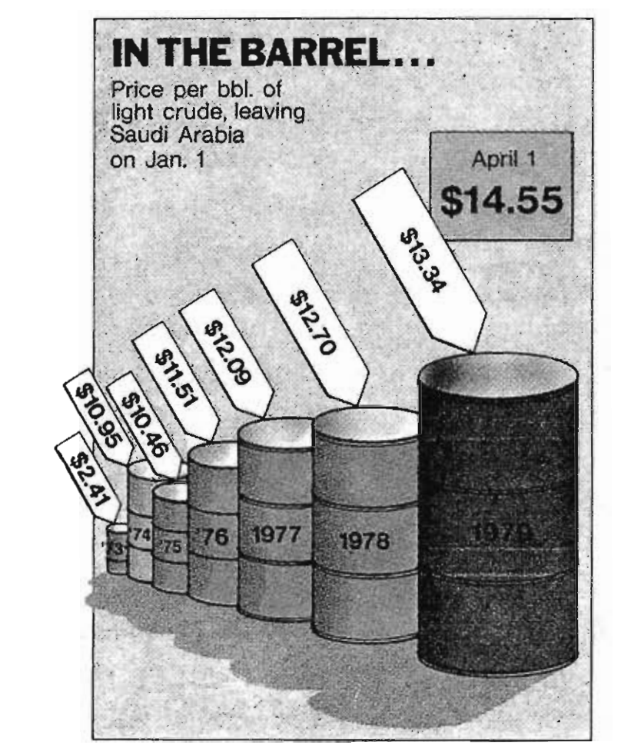
Distortion in statistical graphics
Time,
April 9, 1979
real increase: 454%
shown as: 4280%
lie factor = 9,4

Slide 34
Distortion in statistical graphics
Time,
April 9, 1979
real increase: 454%
shown as: 4280% (2d)
lie factor = 9,4
shown as: 27000% (3d)
3D lie factor = 59,4

Slide 35
Distortion in statistical graphics
Time,
April 9, 1979
2D lie factor = 9,4
3D lie factor = 59,4
The number of information-carrying (variable) dimensions depicted should not exceed the number of dimensions in the data.

Slide 36
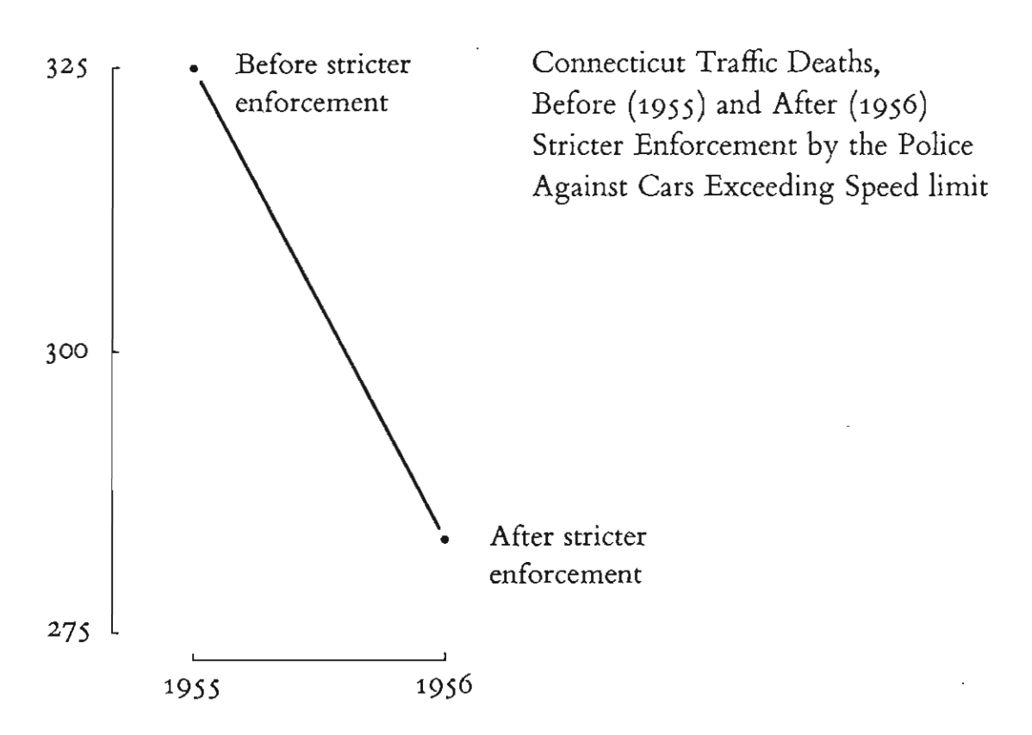
Context: “Compared to what?”

Slide 37
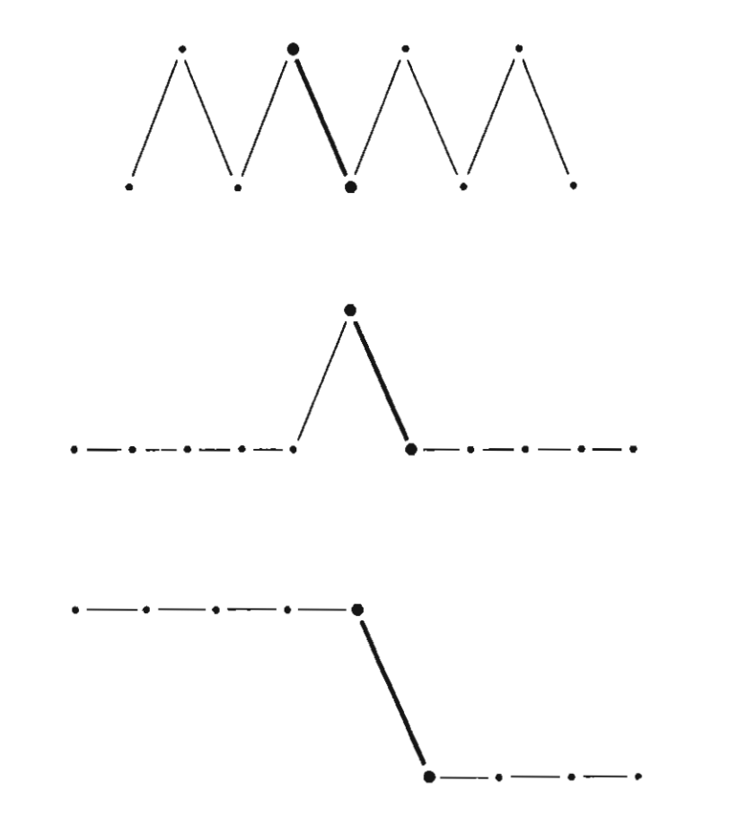
Context: “Compared to what?”

Slide 38
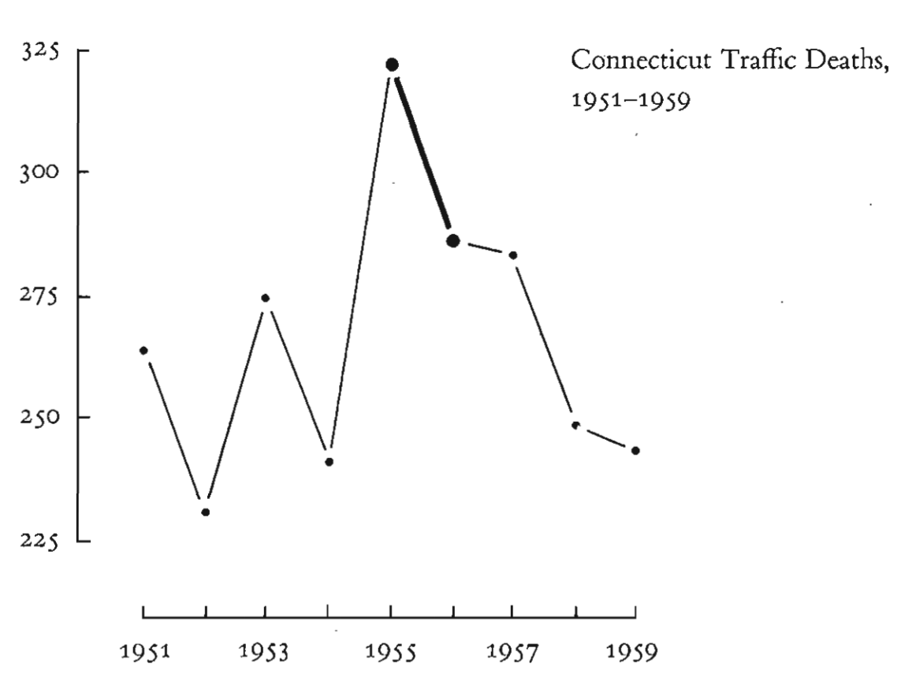
Context: “Compared to what?”

Slide 39
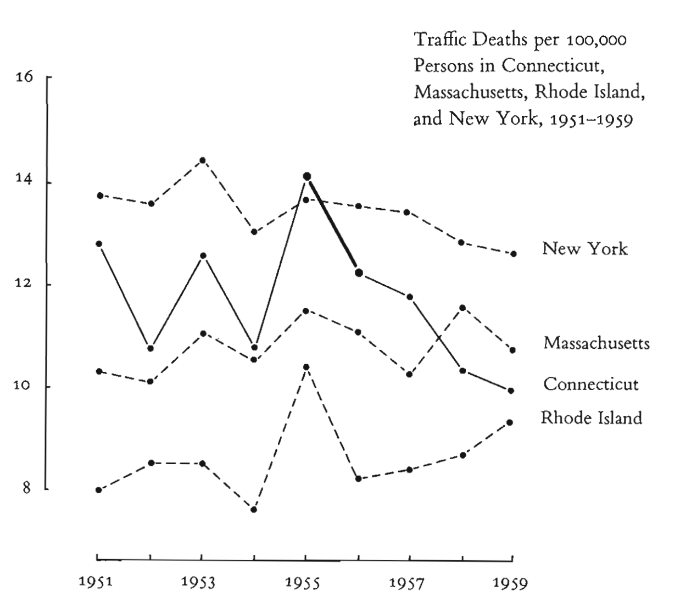
Context: “Compared to what?”

Slide 40
I. Better Product Decisions
II. Excellence in Statistical Graphics
III. Graphical Integrity
IV. One Last Thing: Show the Data

Slide 41
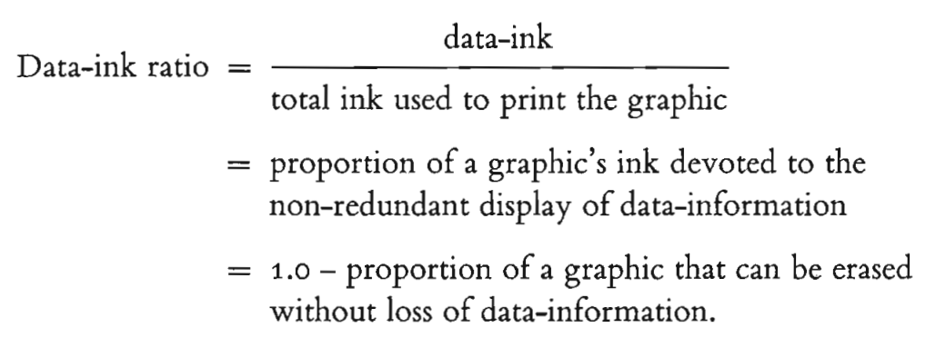
Substance over form
A large share of ink should present data-information.
Tool: measure the ratio of data-ink to total ink
Notes:
Data graphics should draw the attention to the substance of the data, above all else.
A large share of ink on a graphic should present data-information.
Data-ink is the non-erasable core of a graphic, the non-redundant ink.

Slide 42
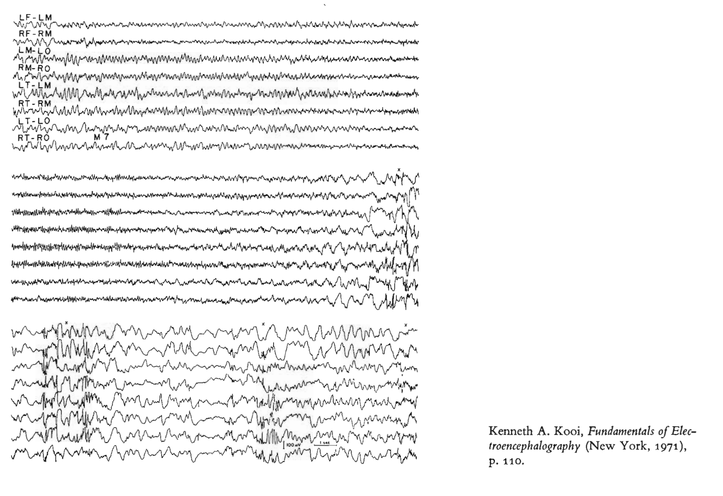
Substance over form
Notes:
In this graphic of an electroencephalography, data-ink = 1.0, nothing can be removed without loss of data, from labels to scale legend to the actual data points.

Slide 43
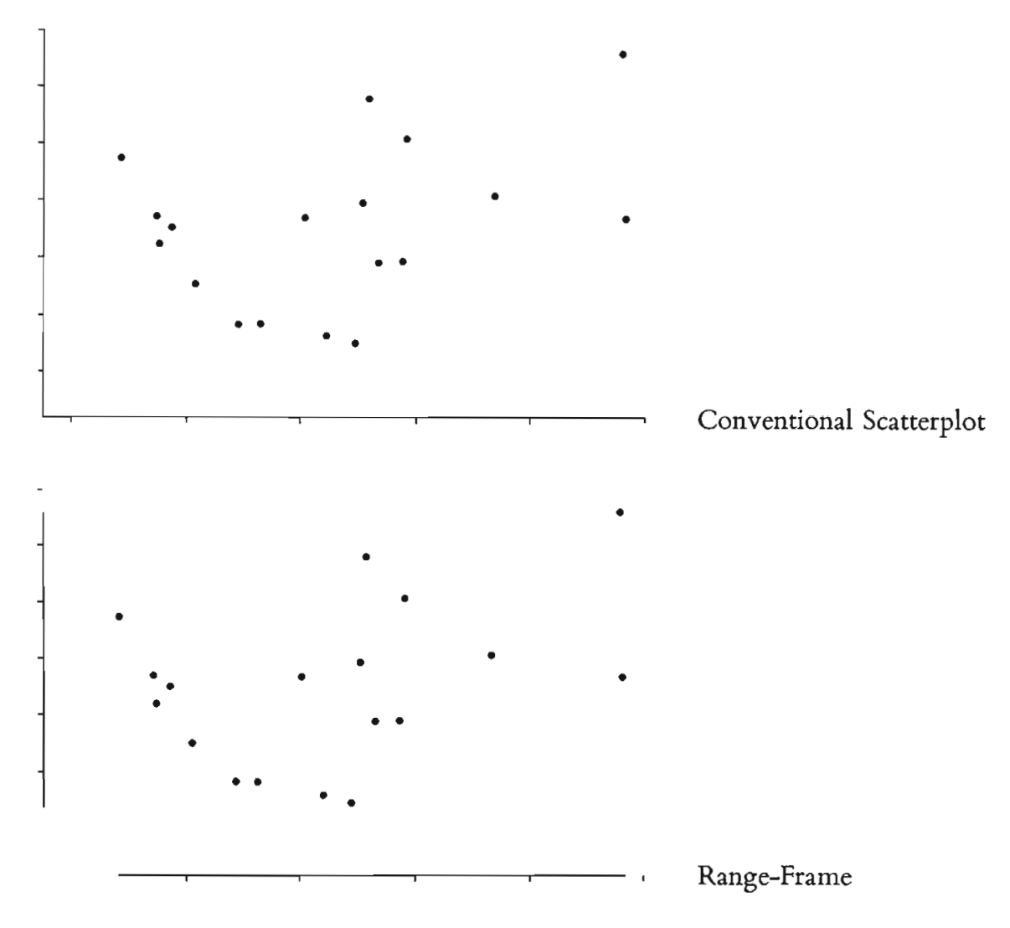
Substance over form
Notes:
Here, by limiting the frame of the axis to the min and max values of both axis, the range-frame now is also encoding data-information instead of being a merely supportive element.

Slide 44
Substance over form
Notes:
Here, by limiting the frame of the axis to the min and max values of both axis, the range-frame now is also encoding data-information instead of being a merely supportive element.

Slide 45
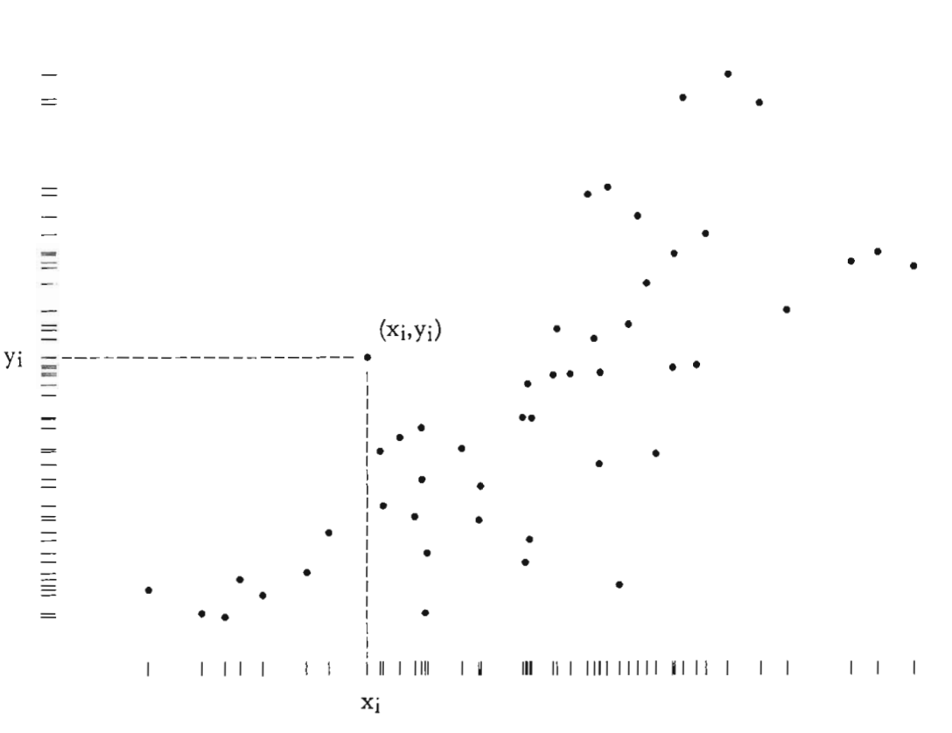
Substance over form
Notes:
Finally, the entire graphic can be turned into data by framing the bivariate scatter plot with the marginal distribution of each variable.

Slide 46
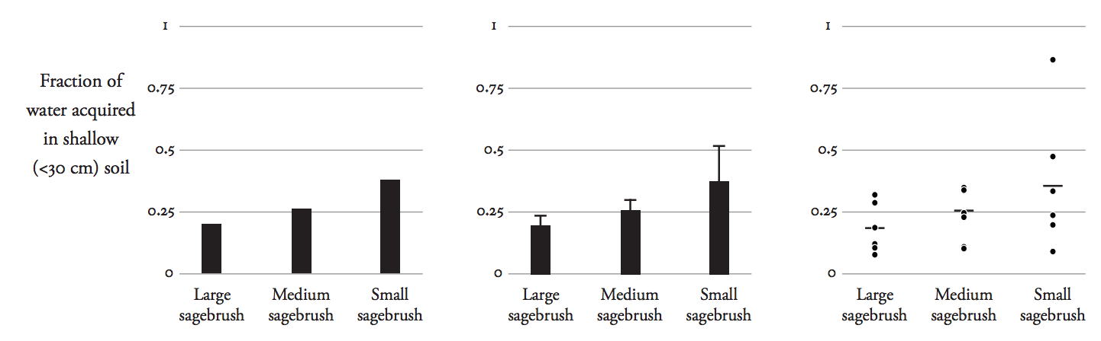
Maximize Data-Ink - Adding ink can help

Slide 47

data
Never
lies

Slide 48
questions?

